Slide 1

Training Project
“CRUD Operation-BookApp Project”
Team-6 Members:
1) Prathamesh Bodhle
2) Chinmay Bangar
3) Srujana Tulluru
Alchemy Solution
Technical Head: Mr Mahesh Sir
Trainer: Mr. Raghu Sir
DXC Technology, India
Notes:
NOTE:
To change the image on this slide, select the picture and delete it. Then click the Pictures icon in the placeholder to insert your own image.

Slide 2
CRUD Operation
C - Create
R - Read
U – Update
D - Delete

Slide 3
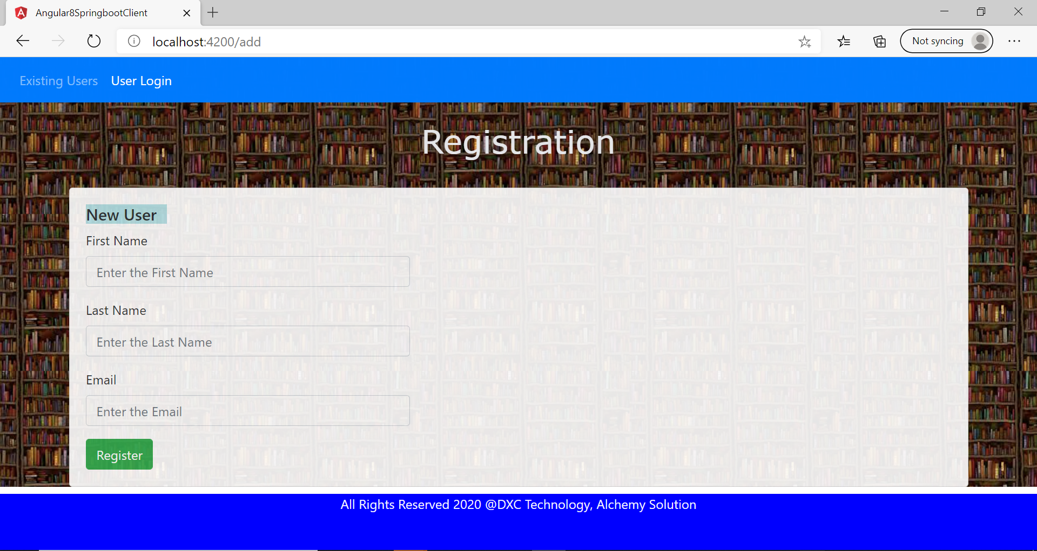
Landing Window

Slide 4
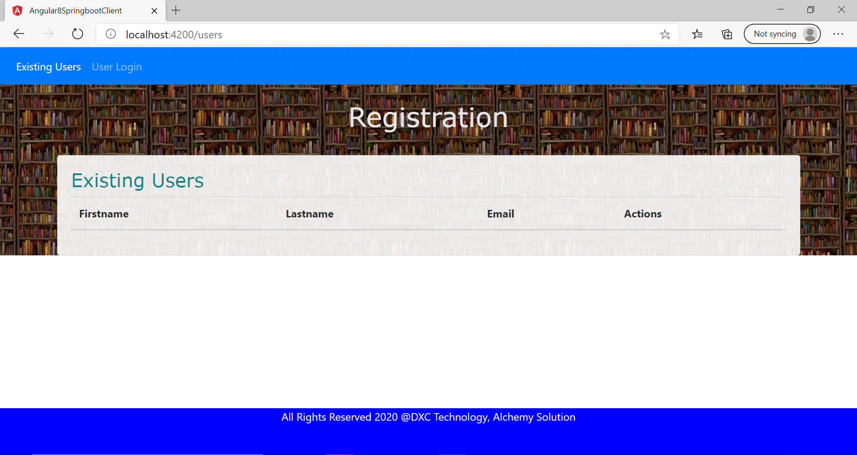
No User Registered..

Slide 5
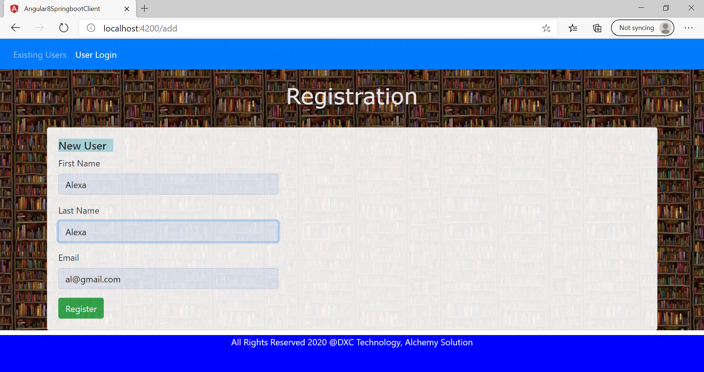
Create(Register) User

Slide 6
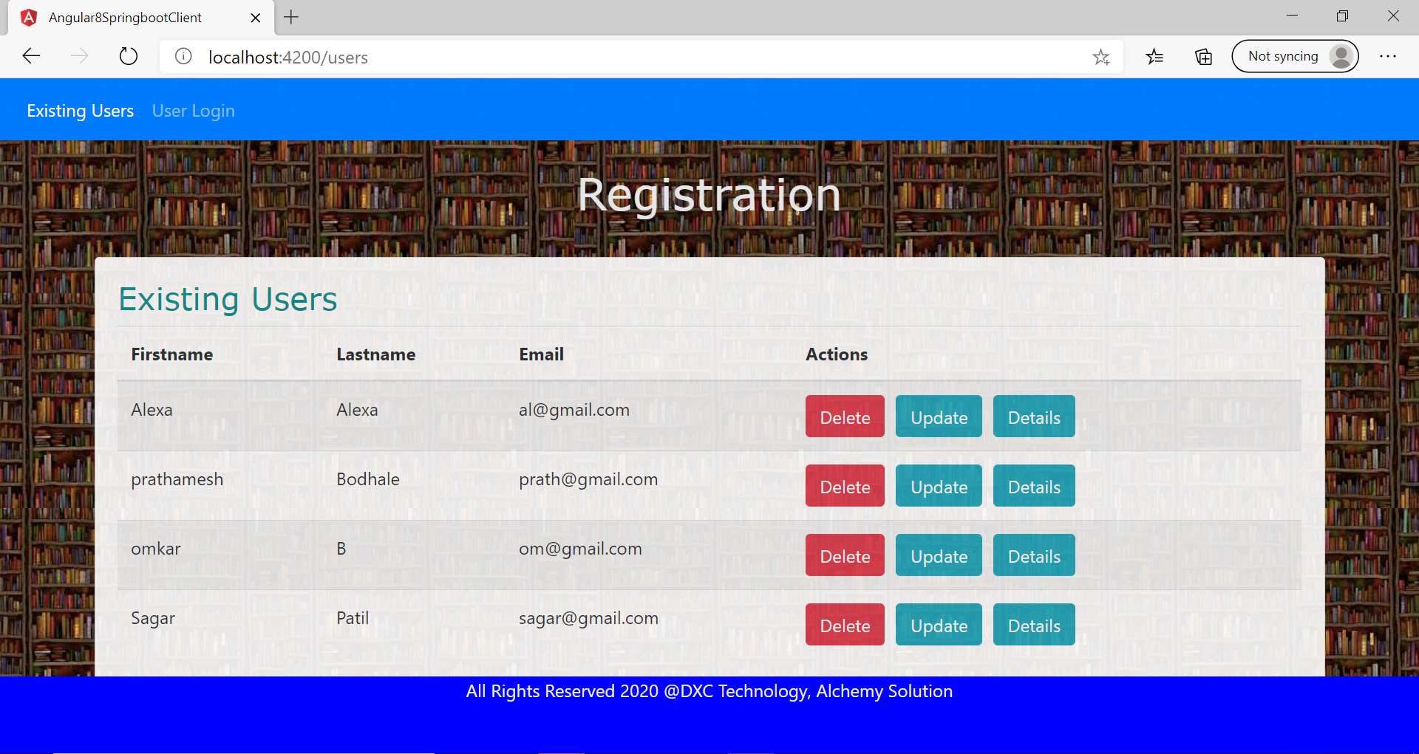
User List

Slide 7
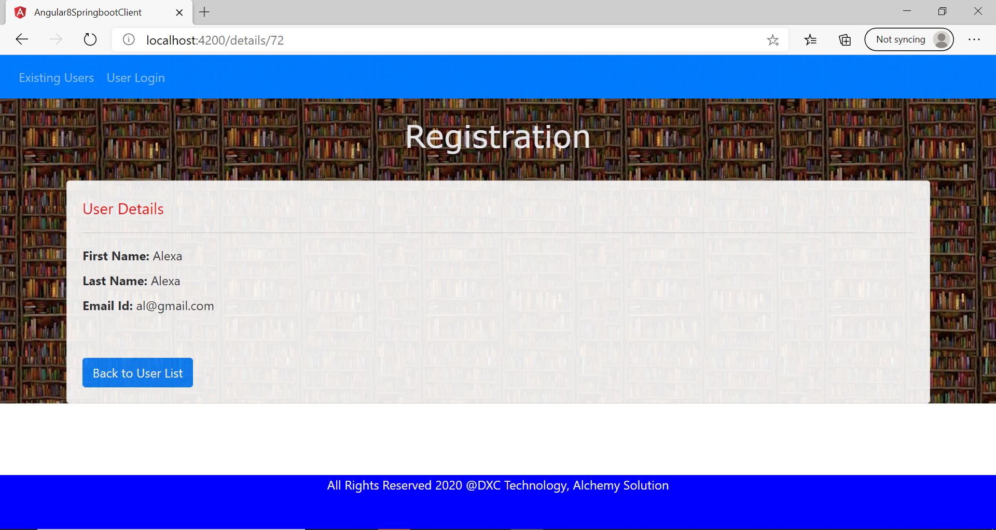
Read-(User Details)

Slide 8
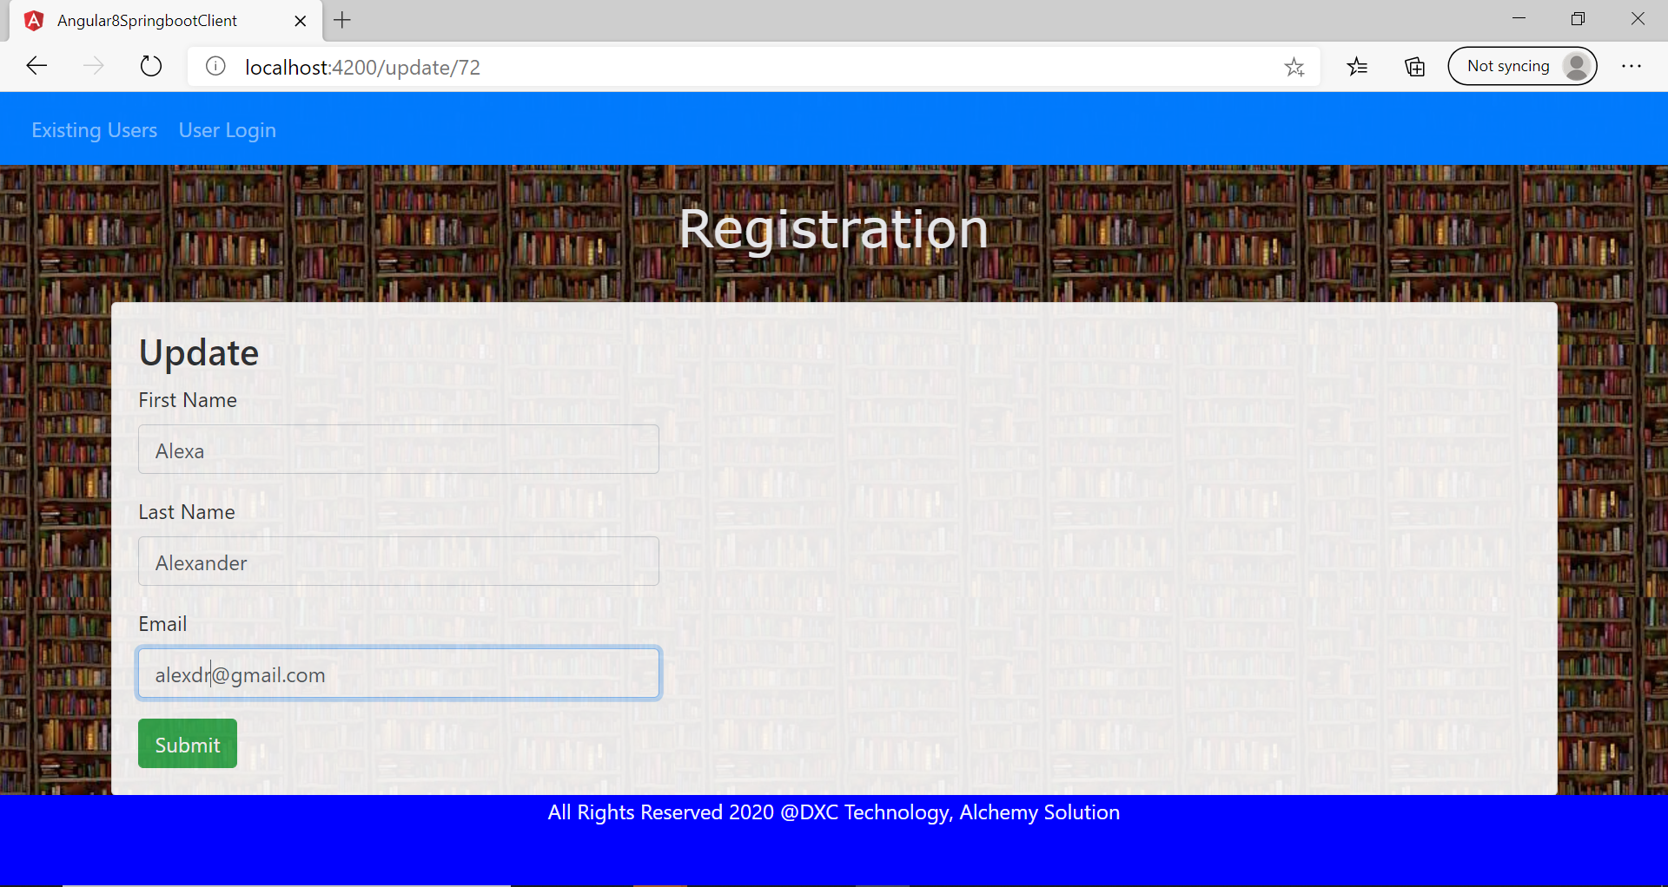
Update- User Details

Slide 9
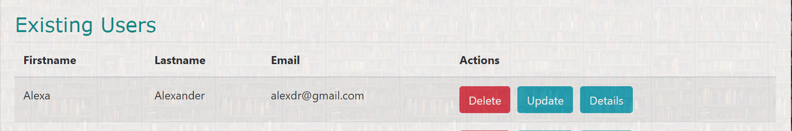
Updated

Slide 10
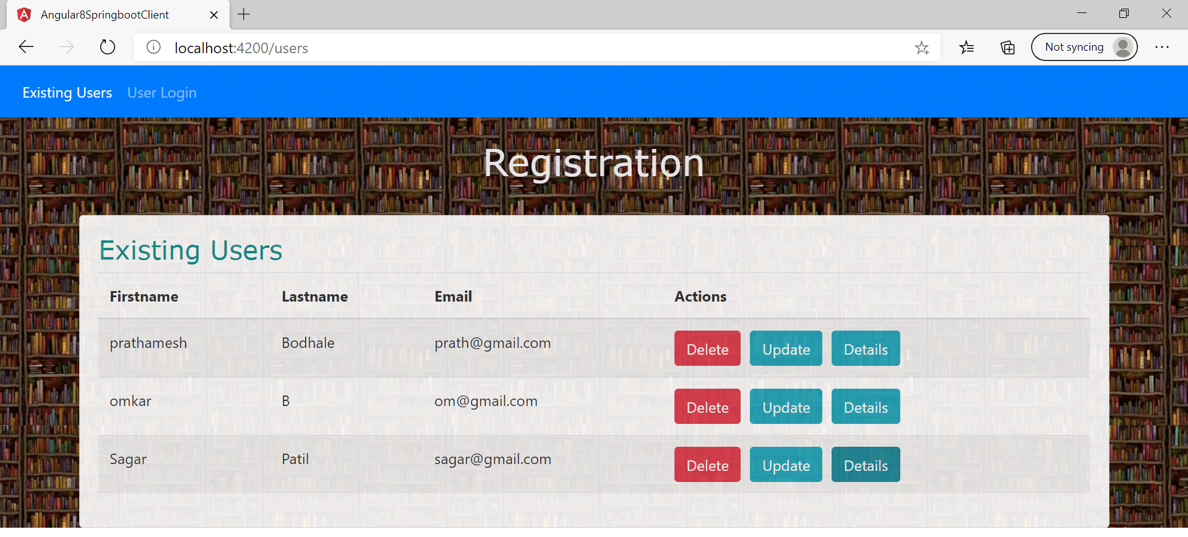
Delete User
The Alexa user has been deleted..

Slide 11
THANK YOU!

